Slide 1
IBM University Engagement Project Submission
“Exploring the Power of Agentic AI with IBM Granite and LangFlow”

Slide 2

Project Tile – Smart Business Idea Generator Agent
Domain of Project – Industry
Student Name | Recent Passport Photo | Email ID | Mobile number [WhatsApp]
Prof. Shivani Shinde |  | shivani2shind15@gmail.com | 8830049312

Slide 3
Problem Statement -
Problem Statement No 12 : Smart Business Idea Generator Agent
-The Challenge
In the digital era, innovation is crucial, but individuals, students, researchers, and organizations often struggle with idea generation. Brainstorming sessions are unstructured, inspiration is scattered across articles, videos, and social media, and existing tools focus on text-only prompts without context-awareness. The challenge is not just to suggest random ideas but to synthesize creativity, context, and relevance into intelligent, actionable ideas for diverse domains such as startups, research, content creation, or product development.
-The Objective
Build an agentic AI Smart Idea Generator that empowers users with contextual, innovative, and multimodal ideation. The solution should:
Fuse Knowledge Sources: Pull insights from articles, research papers, trend analysis, and social platforms to generate contextual and current ideas.
Enable Multimodal Brainstorming: Accept inputs like text prompts, images (e.g., product sketches), or voice notes and refine them into structured, creative suggestions.
Create a Predictive & Agentic Layer: Identify trending domains (e.g., AI in healthcare, sustainable energy), forecast idea relevance, and recommend high-impact directions.
Visualize Idea Maps: Provide an interactive dashboard that organizes ideas into categories, impact scores, and feasibility maps, helping users explore and refine concepts quickly.
Tech Stack (Mandatory)
IBM Langflow / IBM Orchestrate + IBM Models

Slide 4
Technology Stack
IBM Cloud
IBM watsonx Orchestrate
IBM Granite Models
Knowledge Base (Business Ideas Repository)

Slide 5
Proposed Solution -
The proposed solution is a multi-agent AI-powered Smart Business Idea Generator built using IBM Orchestrate, watsonx.ai, and Granite Models to help users generate innovative and market-relevant business ideas.
The system uses a Retrieval-Augmented Generation (RAG) pipeline to gather insights from research papers, business articles, startup databases, and social media trends. Retrieved information is stored in a vector database and processed using Granite models to generate contextual and actionable ideas.
The solution consists of four key agents:
Idea Discovery Agent – Collects and analyzes trends, research, and market opportunities.
Business Innovation Agent – Generates personalized business ideas based on user interests, budget, and goals.
Trend Forecasting Agent – Identifies emerging technologies and predicts high-potential business domains.
Idea Validation Agent – Evaluates ideas based on feasibility, market demand, scalability, and innovation.
An interactive Streamlit/React dashboard visualizes idea maps, trend insights, feasibility scores, and business opportunities. RAG orchestrates agent workflows, while watsonx.ai ensures scalable AI deployment and governance.
Overall, the solution provides an intelligent platform for generating, validating, and refining business ideas through AI-driven creativity, trend analysis, and decision support.

Slide 6
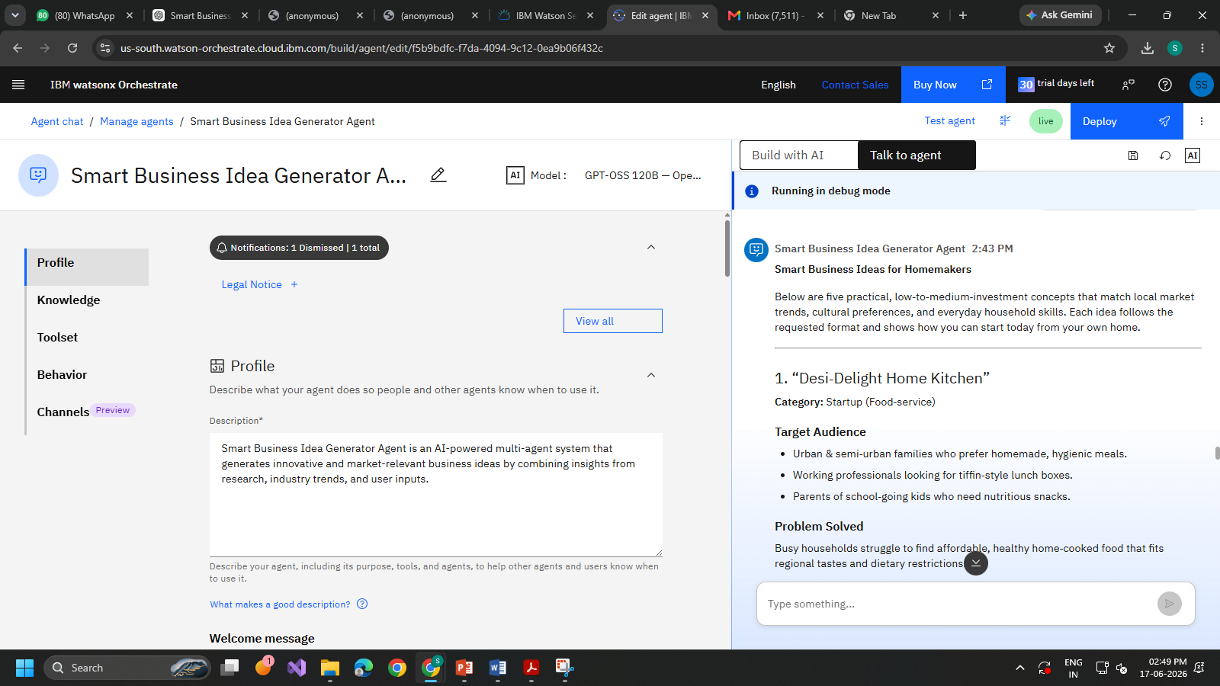
Result

Slide 7
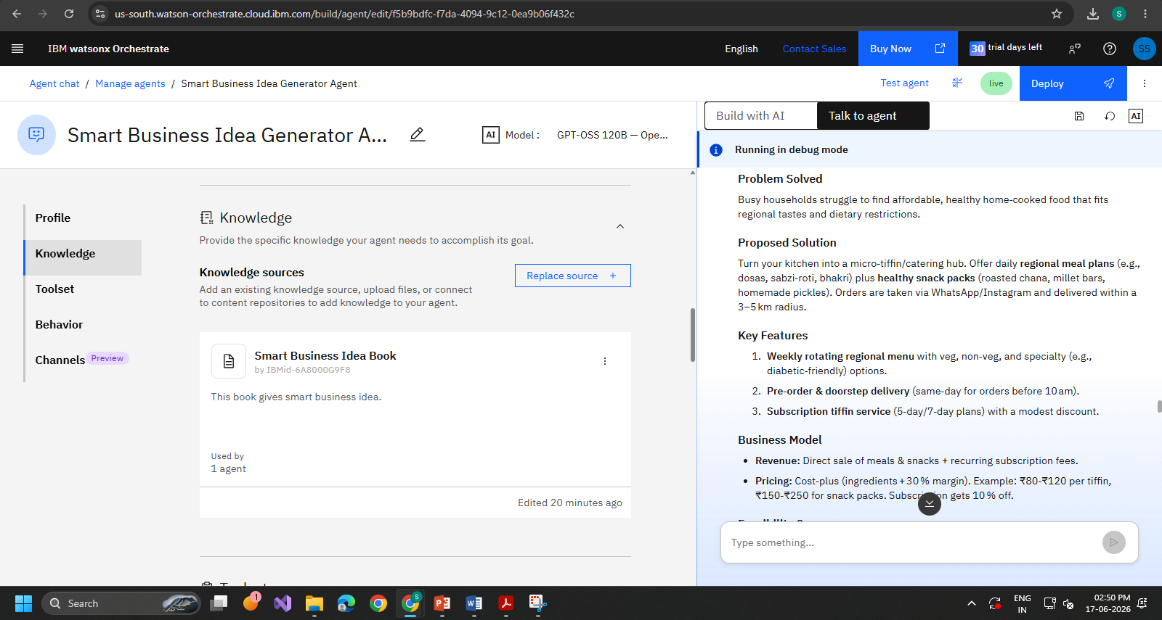
Result Continued

Slide 8
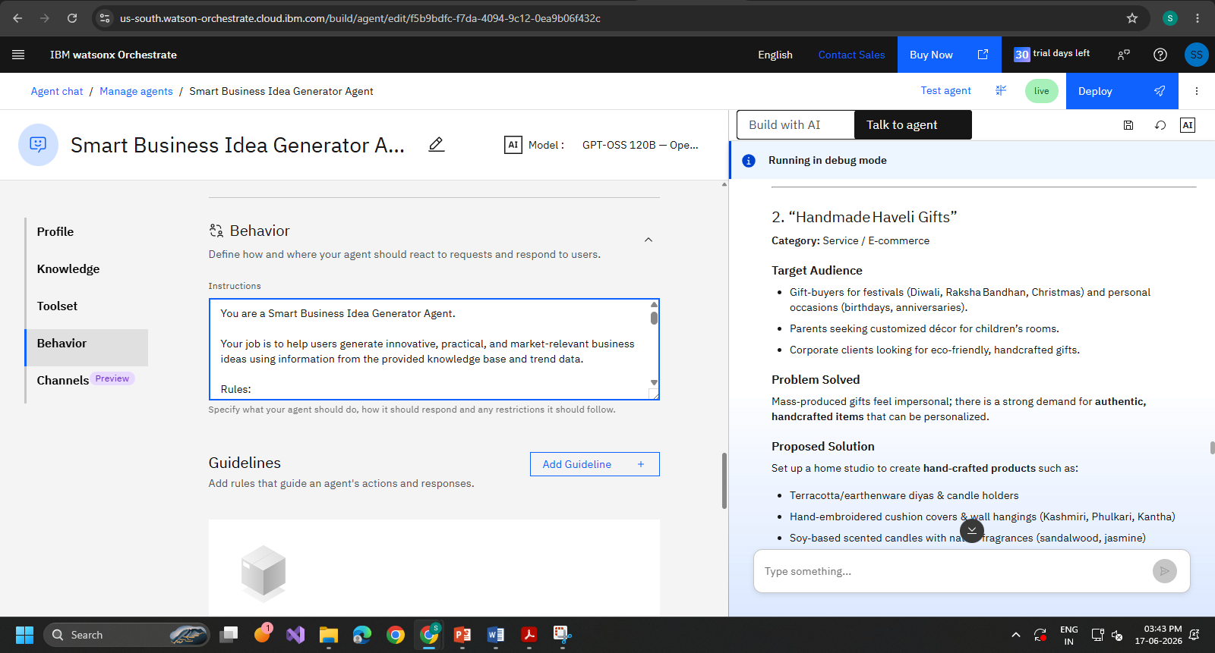
Result Continued

Slide 9

Role of Agentic AI in the solution
Agentic AI enables the Smart Business Idea Generator to act as an intelligent innovation assistant rather than a simple idea-generation tool. Using IBM watsonx.ai and Granite Models, it coordinates multiple agents to discover trends, generate business ideas, forecast opportunities, and validate feasibility.
The agents work collaboratively, understand user preferences and goals, and provide personalized, market-relevant business suggestions. They continuously analyze emerging trends and refine ideas based on real-time insights.
Overall, Agentic AI makes the system proactive, context-aware, and goal-driven, helping users generate innovative and high-potential business ideas efficiently.

Slide 10
Technology Used
IBM watsonx Orchestrate is an AI-powered automation platform that enables organizations to
build, manage, and coordinate intelligent agents and workflows to automate complex business tasks efficiently.
IBM Grainte model - for groq/openai/gpt-oss-120b– For natural language understanding, reasoning, and personalization
IBM Cloud – It provides the infrastructure to build, deploy, and scale the Nutrition Agent efficiently. IBM Cloud enables a reliable, secure, and scalable environment for deploying the Nutrition Agent.
RAG– RAG to fetch real data first, then generate intelligent answers, making the Nutrition Agent more trustworthy and effective.

Slide 11
Novelty and Uniqueness
The proposed Smart Business Idea Generator Agent stands out by combining Agentic AI, knowledge-driven reasoning, and trend-based innovation into a single intelligent platform.
Multi-Agent Intelligence – Multiple specialized agents collaborate to discover trends, generate ideas, validate feasibility, and refine business opportunities instead of relying on a single AI model.
Knowledge-Driven Idea Generation – Utilizes a business knowledge base and RAG-based retrieval to generate contextual, relevant, and actionable ideas rather than random suggestions.
Personalized Recommendations – Tailors business ideas based on user skills, interests, budget, industry preferences, and goals.
Trend-Aware Innovation – Identifies emerging technologies and market trends to recommend future-ready and high-potential business opportunities.
Idea Validation Layer – Evaluates ideas for feasibility, scalability, market demand, and potential impact before presenting recommendations.
Interactive Idea Exploration – Organizes ideas into categories, impact scores, and feasibility maps, helping users compare and refine concepts efficiently.
Scalable & Enterprise-Ready – Built on IBM Cloud, watsonx Orchestrate, and Granite Models, ensuring reliability, scalability, and AI governance.

Slide 12
Git Hub Link
https://github.com/s2shinde15/Smart_Business_Idea_Generator_Agent.git
·
·
·

Slide 13
Future Scope
1. Real-Time Market Trend Integration The system can be integrated with market reports, startup databases, news sources, and social media platforms to identify emerging business opportunities. This will enable the agent to generate more relevant and future-ready business ideas based on current industry trends.
2. Multimodal Idea Generation & Voice Assistant Future versions can support text, voice, and image inputs, allowing users to submit product sketches, voice notes, or business concepts. With multilingual voice assistance, users can interact naturally in their preferred language, making the platform more accessible and user-friendly.
3. AI-Based Feasibility & Market Analysis The agent can be enhanced with predictive analytics to assess market demand, competition, investment requirements, and potential profitability. This will help users evaluate the viability of business ideas before implementation.
·
·
·

Slide 14


